Slide 1
American Federation of Teachers
AFT-Y is YOUR union!
And AFT-Y is part of the larger AFT organization

Slide 3
What has AFT-WA done for us lately?
Recent State “Wins”
McCleary for K-12 (Running Start)
The right to bargain local funds
Washington Colleges Grant – full funding
Nurse Educator Salaries (WED)
High Demand (WED)
Counseling bill
Cost of Living Adjustment

Slide 4
Next up for AFT-WA

Slide 5
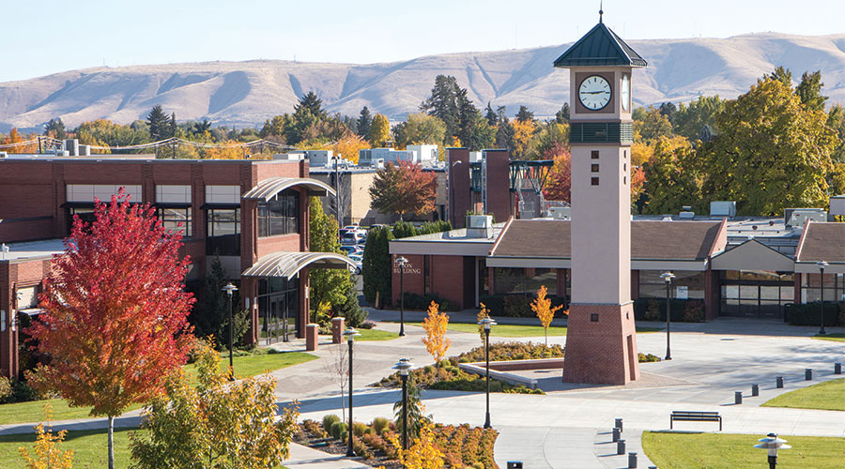
What has AFT-Y done for us lately?

Slide 6
Collective Bargaining Agreement (CBA)
Our Contract
Outlines working conditions/expectations/rights
We begin bargaining for a new CBA (revisions) this winter/spring (usually the contract lasts 2 years)
The CBA is a working document, which can be amended, changed, and improved through bargaining or official agreements between AFT and Adminstration

Slide 7
Where to find our CBA: https://www.yvcc.edu/human-resources/

Slide 8
AFT-Y is for Faculty, AFT-YPS is for Professional Staff
Or you can ask for a paper copy in HR. Your union reps may also have extra copies.

Slide 9
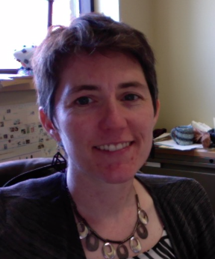
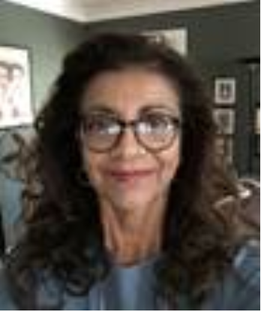
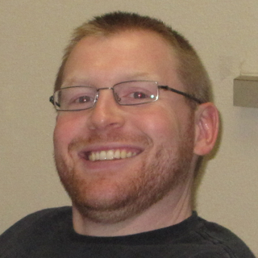
Your Representatives
Rachel Dorn, AFT President
Maria Cuevas, AFT Treasurer
Brock Eubanks, AFT Secretary
Palmer Martin (building 20) room 170
574-4844
rdorn@yvcc.edu
Glenn-Anthon (building 4) 161
574-6800 x3151
mcuevas@yvcc.edu
Glenn-Anthon (building 4)
Room 175
574-6800 x3226
beubanks@yvcc.edu

Slide 10
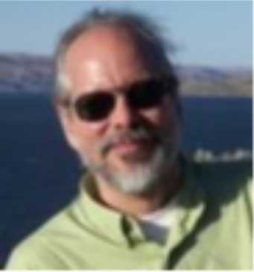
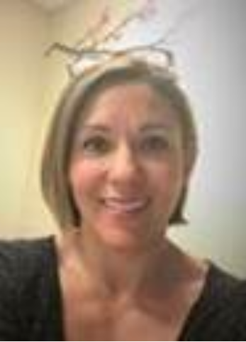
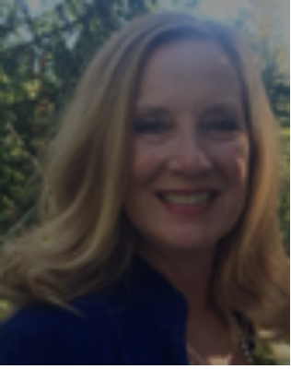
Your Representatives
Stephen Rodrigue, VP for Arts & Sciences
Eva Cunningham, VP for Student Services
Susan Klaus, VP for Workforce Education
Engineering/Physics (bldg 34)
room 118
574-4854
srodrigue@yvcc.edu
Raymond Hall (building 7)
room 112
574-4985
ecunningham@yvcc.edu
Technology (building 24)
room 200C
574-4767
sklaus@yvcc.edu

Slide 11
What your reps can do for you:
Support you in an investigation/disagreement with deans/administration
Help you navigate your rights in the CBA
Advocate for changes that benefit faculty and the school as a whole
Help answer questions about your rights, expectations, working conditions, compensation, etc
Some examples of specific things AFT reps have helped with recently: (arranging maternity leave, leave of absence, discrepancy in seniority listing, unusual class times, salary placement, disagreement about job duties)

Slide 12
Recent changes in CBA that benefit faculty and school:
$$ for announcing retirement early (to help speed up hiring process
Funding for Salary Increments (steps)
Office hours clarification (5 per wee instead of each day to accommodate uneven schedules and online teaching
3 years to re-negotiate initial salary placement

Slide 13
You can Influence the Union!
Join Contract Committee (you can be a visible or invisible member) to work on general or specific issues
Join the Bargaining team
Bring issues to your reps (issues can be tackled by the contract committee or discussed with admin)
Join the food / membership / events committees (make sure we have both food and drinks at future events, help members understand their benefits, help keep faculty connected to the union)
Be the AFT-Y rep on state or local committees (COPE, ROC, Central Labor Council, etc)
Keep track of state or national issues (legislative changes, and upcoming bills, changes in other CBAs, etc)

Slide 14
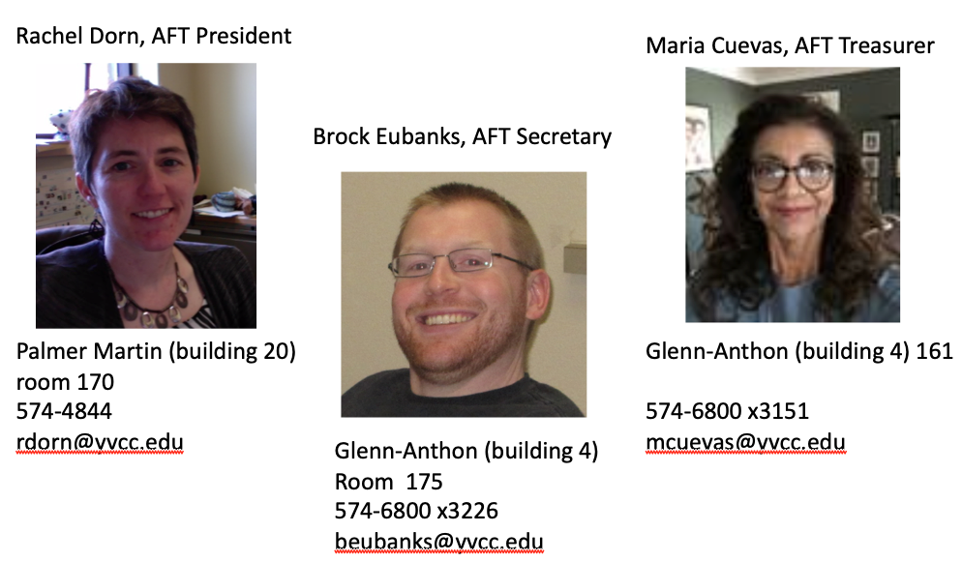
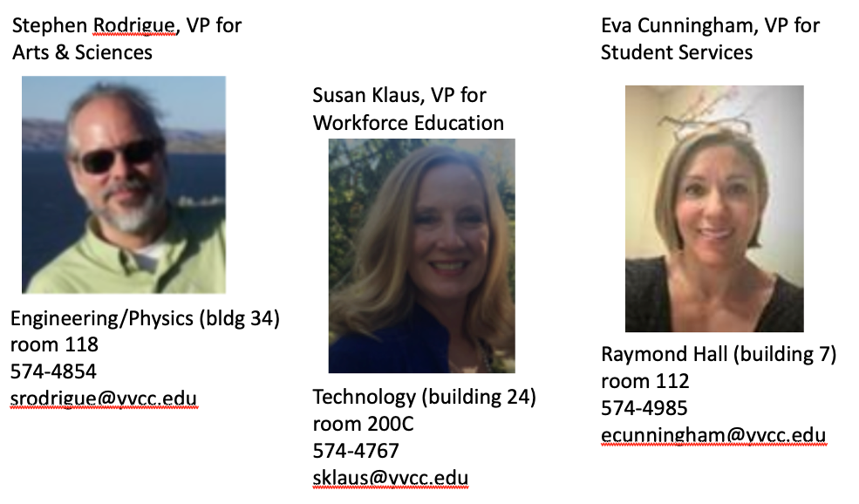
Join us & Get Involved!
BECOME A MEMBER! (see your rep for membership applications)
Talk to your reps!
Work with union leadership if you have a problem or concern
Be Visible (Wear an AFT pin/shirt, etc)

